Slide 1
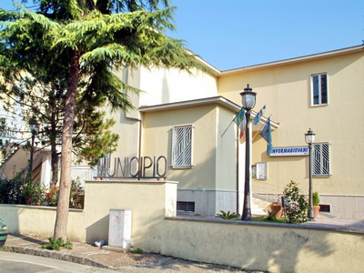
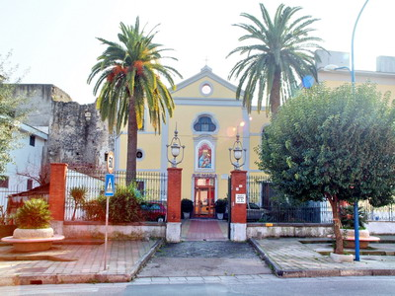
HERE IS MARIGLIANELLA

Slide 2
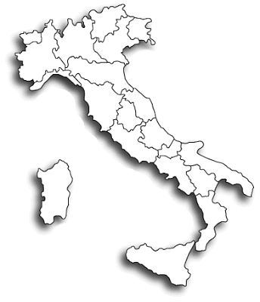
MARIGLIANELLA IS IN ITALY
MARIGLIANELLA

Slide 3
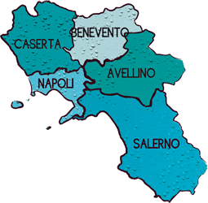
MARIGLIANELLA
MARIGLIANELLA IS IN CAMPANIA

Slide 4
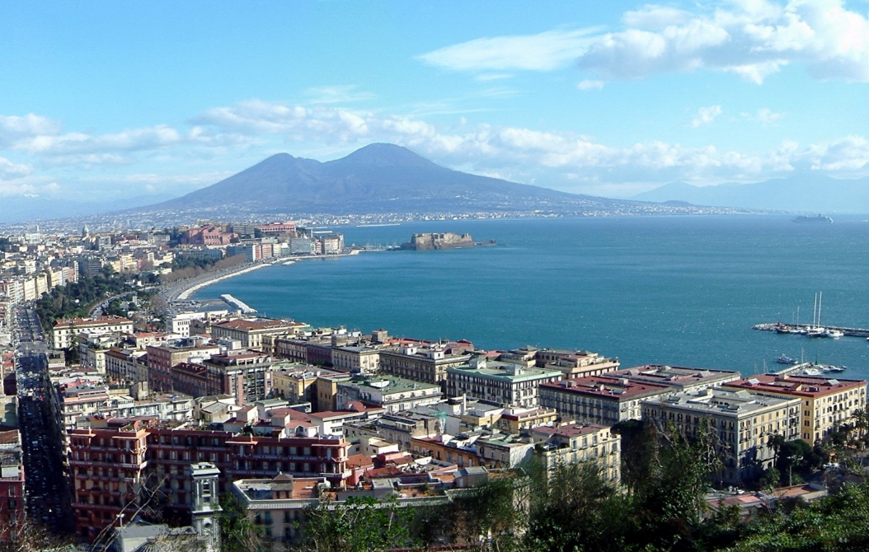
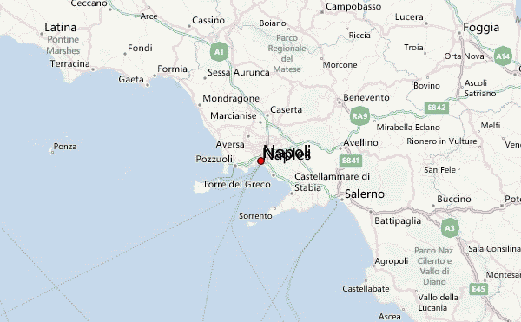
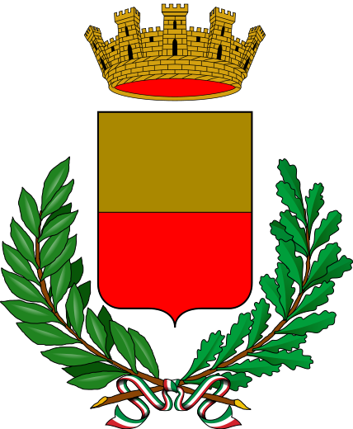
MARIGLIANELLA IS NEAR NAPLES

Slide 5
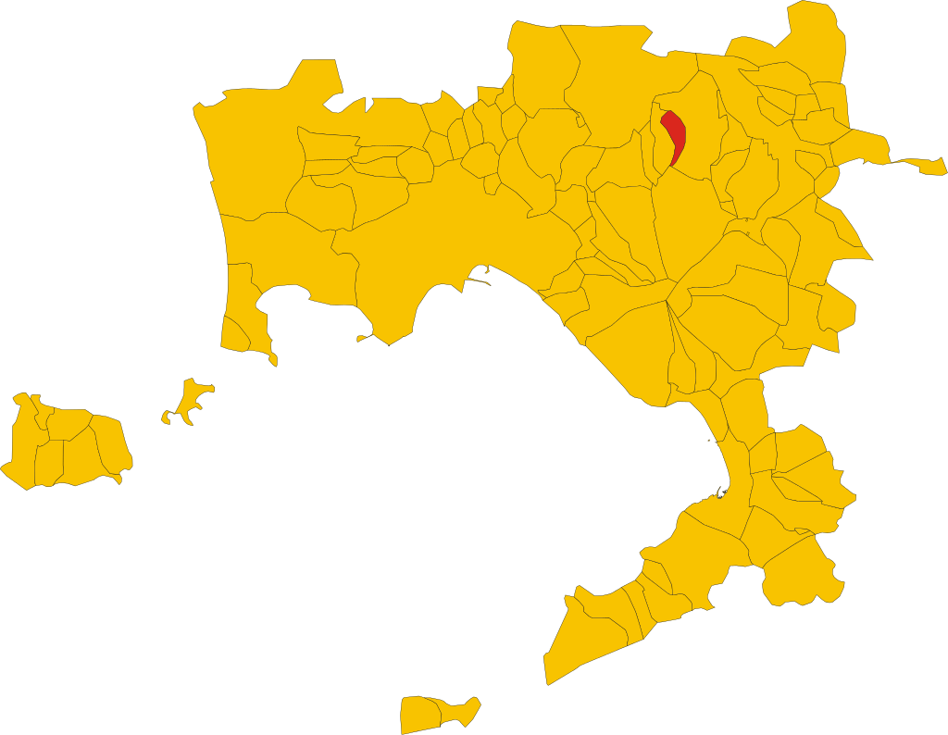
TERRITORY OF MARIGLIANELLA
MARIGLIANELLA IS THE SMALLEST TOWN FOR INHABITANTS AND SURFACE IN THE NORTH-EAST OF NAPELS

Slide 6
MUNICIPALITY OF Mariglianella
Number Inhabitans:7572
Surface:3,26Km²
Density:2290,8 ab./km²
Neighbouring towns: Brusciano, Marigliano e Somma Vesuviana

Slide 7
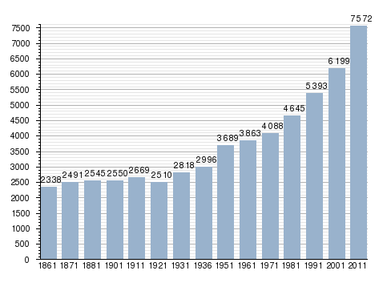
INCREASING OF POPULATION
From 1861 to 2011 there was a constant increasing of population from 2338 inhabitans in 1861 to 7572 in 2011.

Slide 8
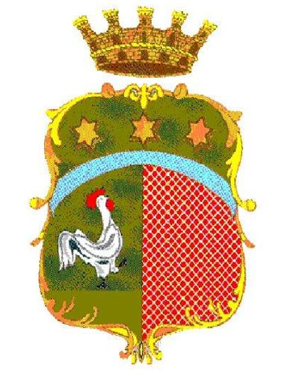
THE COAT OF ARMS OF MARIGLIANELLA
The coat of arms of Mariglianella has a crown with five towers on it which gives the idea of regality and the medieval character of towns with towers to protect theirself from enemies attacks.
Under these pictures there are three stars in the middle. The meaning of the three stars is of religious order.
Under them,on the left there is a cock,while on the right, the coat has a red strip.
The presence of a cock indicates the agricultural character of the town in the centuries.

Slide 9
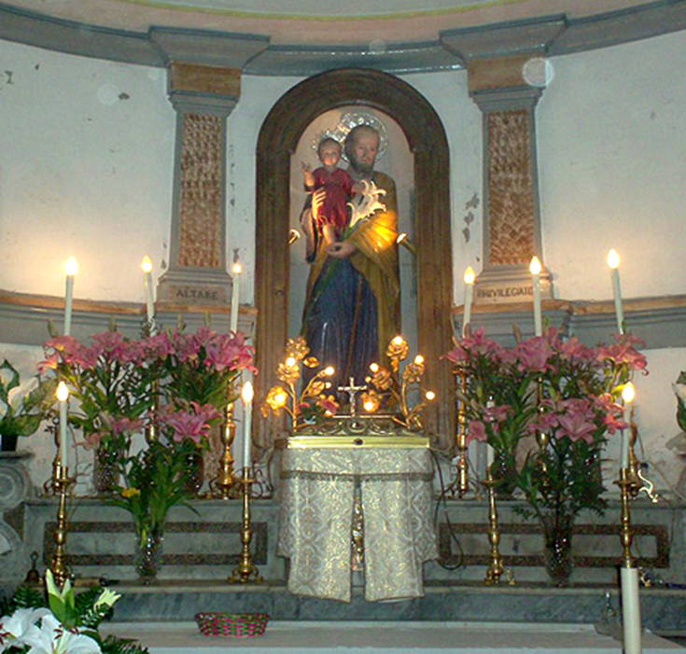
ST. JOSEPH’ CHURCH
The church is small, but full of memory and history. It is located in Via Materdomini and was owned by the Tramontano family. It was originally built as a chapel dedicated to St. Mary of Materdomini. In fact, the fame of the miracles of Vergine Maria of Materdomini, a place near the town of Avellino, had spread to many other countries, including Mariglianella. However, many believers were unable to visit the image of the Virgin Materdomini in the church, because it was a lot away (about 20 miles from our country). Thus, a man named Simon donated to the inhabitants of Mariglianella two houses to build a church where people could practice the cult. Today, this church is used only on special occasions: the feast in honor of St. Joseph on March 19, and May 1.

Slide 10
THE CHURCH OF S. MARIA DELLA SANITÀ
The old name of S. Maria della Sanità was S. Eucalione .
Carlo Carafa ,the famous dominican friar,changed the name of the church with the present name.
Later,he built a covent near this church,where the dominicans lived for about 60 years.
From 1947 to 1955 , three classrooms for children were built and later was founded an orphanage ,too.
The church was painted and decorated again some years ago.
On sundays the believers go to the church for listening to the Mess and asking the Virgin for a benediction.

Slide 11
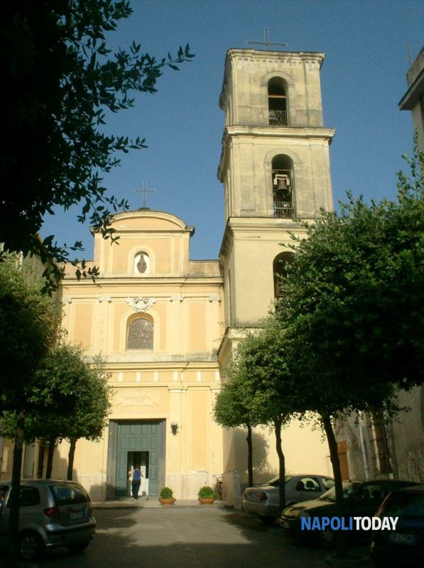
ST. GIOVANNI EVANGELISTA CHURCH
The church is dedicated to the saint patron of our country: St. Giovanni Evangelista. We don’t know when it was built, but it is one of the oldest public works arisen in Mariglianella. Moreover, in the past the church had another name. On it, we can get some information by two memorial stones placed at the entrance to the church. The inscription on one of it dates back to the seventeenth century. During the second World War, the church was semi-destroyed and later restored. The church has a Latin cross. To the right and left you can be seen in all seven small chapels inside of which there are several statues of Saints and a dead Jesus.

Slide 12
The main streets of Mariglianella are:
Via Roma
Via Marconi
Via Materdomini
Via Torino

Slide 13
This work was realized
by Orlandino Silvestro and Mennella Antonio II E
a.s. 2016/17

