Slide 1
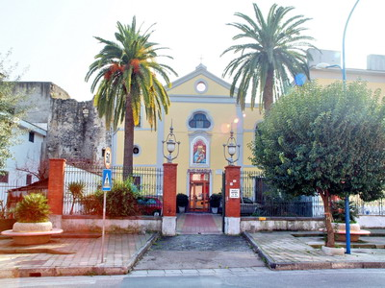
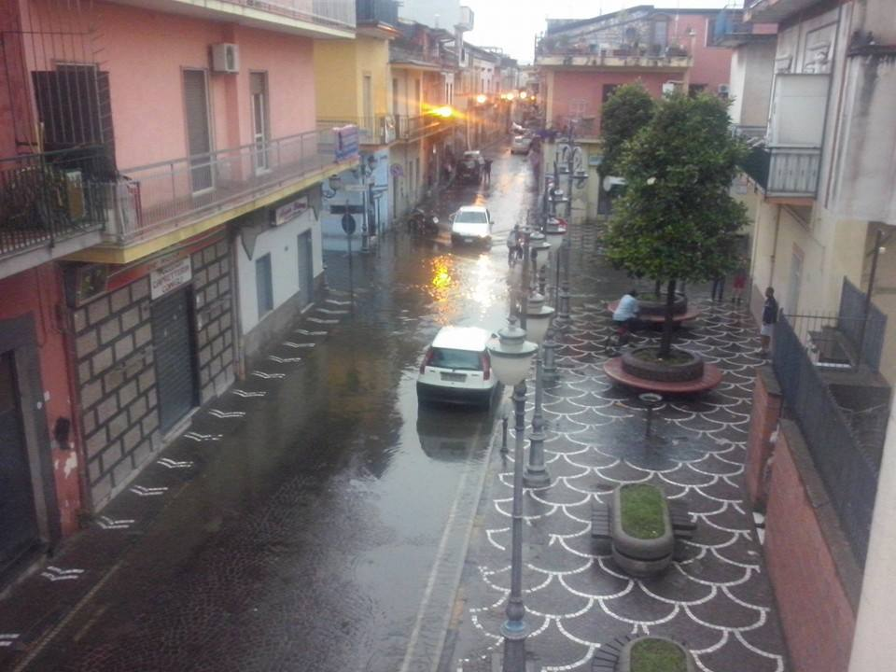
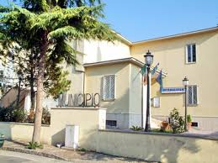
HERE IS MARIGLIANELLA

Slide 2
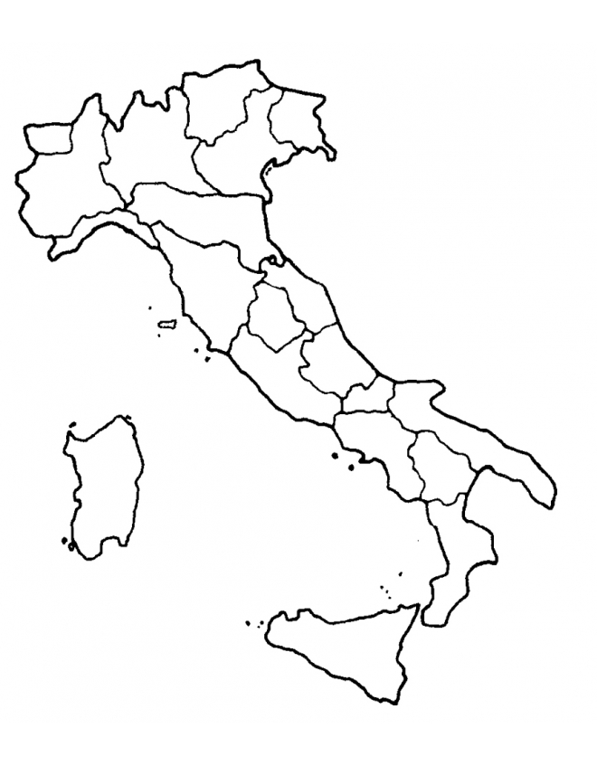
MARIGLIANELLA IS IN ITALY

Slide 3
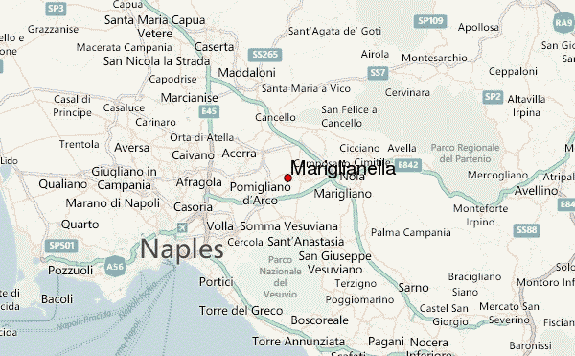
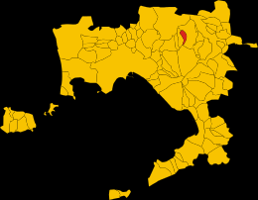
MARIGLIANELLA IS IN CAMPANIA

Slide 4
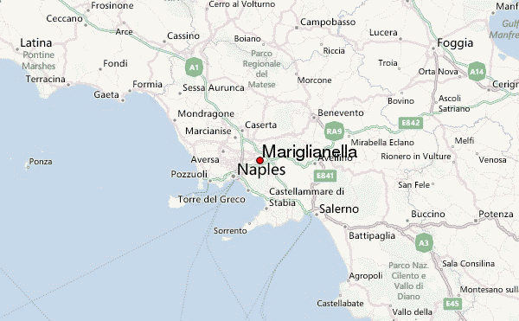
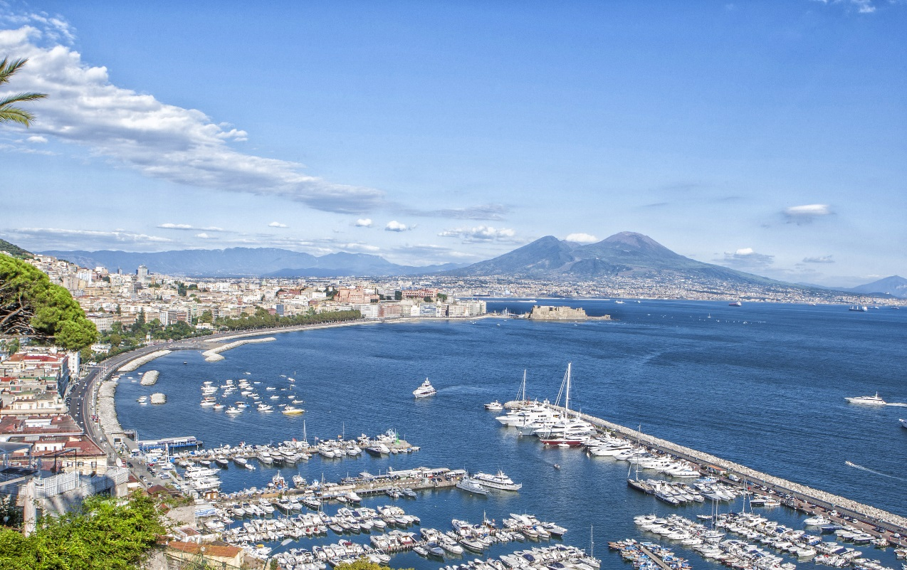
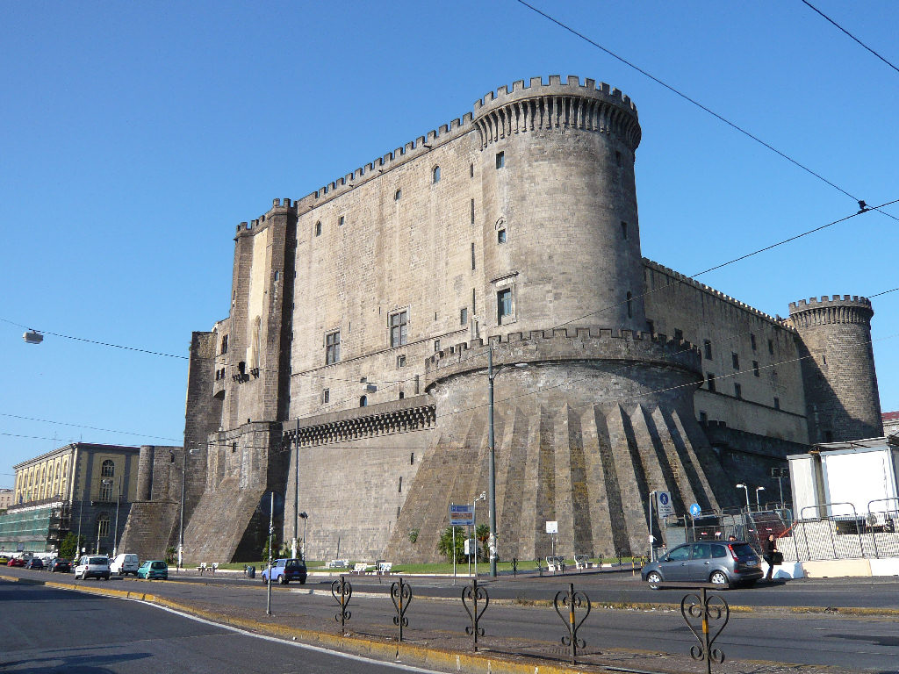
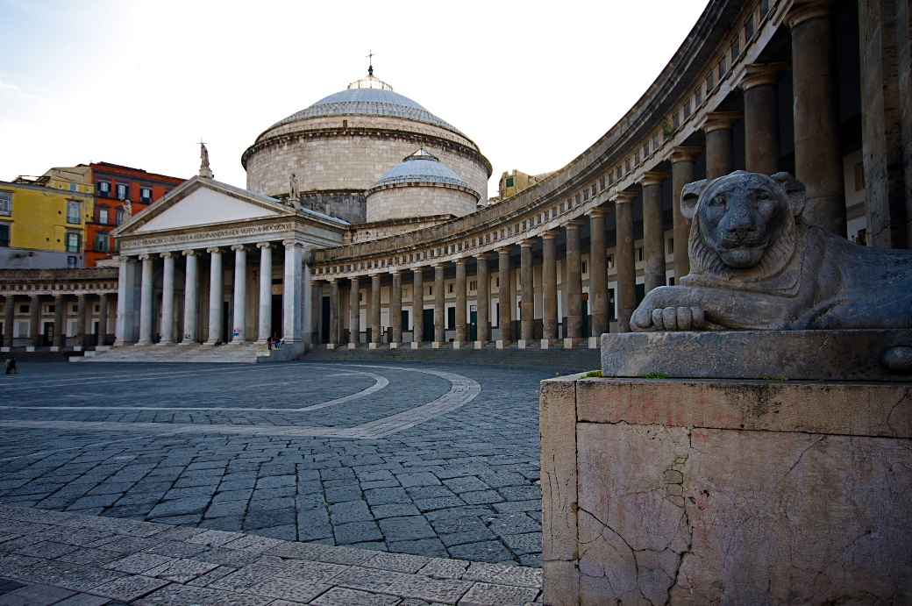
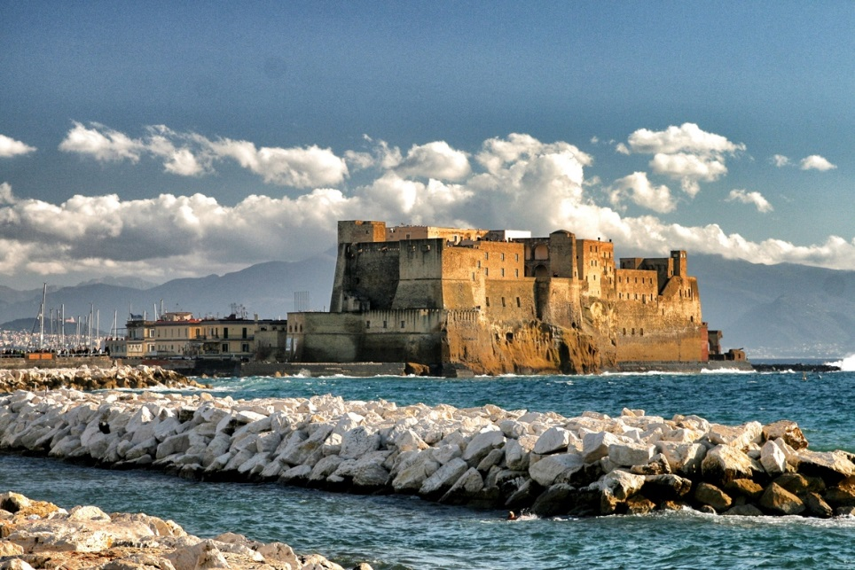
MARIGLIANELLA IS NEAR NAPLES

Slide 5
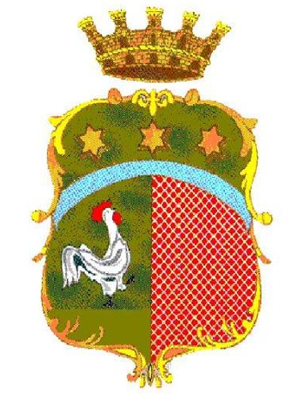
THE COAT OF ARMS OF MARIGLIANELLA
The coat of arms of the town of Mariglianella depicts a crown surmounted by four towers, which give the idea of ​​royalty and characterize medieval towns which defend themselves against enemy assaults.
Under these two figures, three stars appear at the centre. The meaning of the three Stars is of religious origin. Below, on the left, there is a rooster, while on the right there is a red stripe. The presence of the rooster indicates the charater predominantily agricultural that Mariglianella has had over the centuries

Slide 6
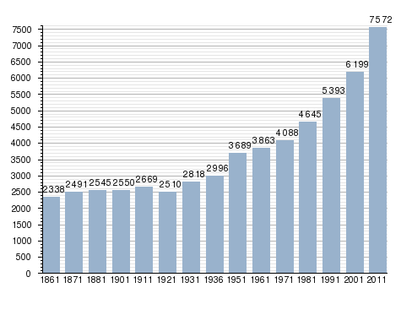
POPULATION INCREASE

Slide 7
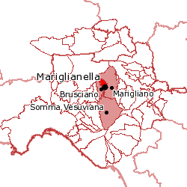
TERRITORY OF MARIGLIANELLA
Inhabitants=7412
Area=3,26 km2
Density=2290,8 ab.\km2
Neighboring towns=Brusciano,Marigliano, Somma Vesuviana

Slide 8
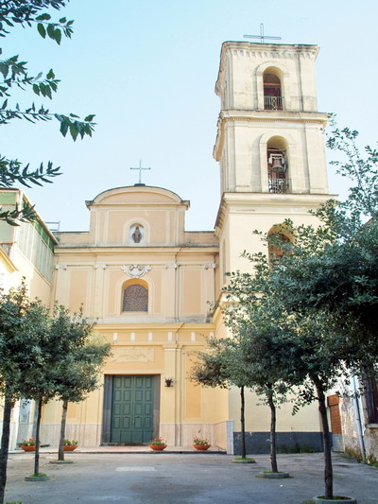
THE CHURCH OF SAN GIOVANNI EVANGELISTA
The church is dedicated to the patron saint of our VILLAGE: St. Giovanni Evangelista. We do not know when it was built, but it is one of the oldest public works arisen in Mariglianella. Moreover, in the past, this church had another name.
On it we can extract some information from two commemorative plaques at the entrance of the church. The inscription on one of it dates back to the seventeenth century.
During the Second World War, the church was semi-destroyed and later restored.
The church has a Latin cross. On the right and on the left you can see across seven small chapels, inside of which there are several statues of saints and a dead Jesus.

Slide 9
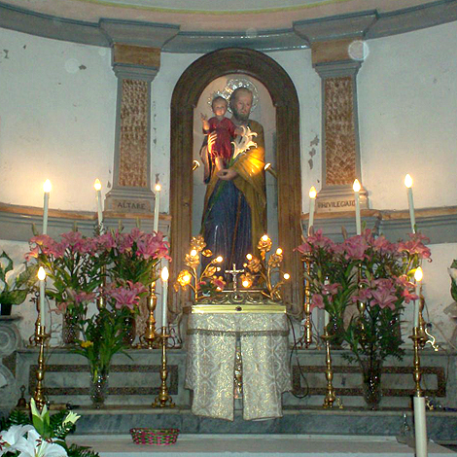
THE CHURCH OF SAN GIUSEPPE
The church is small, but full of memory and history. It is located in Via Materdomini
It was owned by the Tramontano family. It was originally built as a chapel entitled to St. Mary of Materdomini.
In fact, the fame of the miracles of the Virgin Mary of Materdomini, a place near Avellino
had spread to many other towns , including Mariglianella. However, many believers could not visit to the image of the Virgin in Materdomini Church, because it was far away.
So a man named Simon donated to the inhabitants of Mariglianella two houses to build a church where people could practice the cult. Today this church is used only on special occasions :the festival in honor of St. Joseph on March 19 and May 1

Slide 10
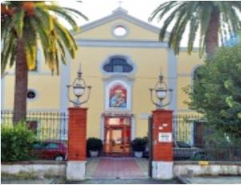
THE CHURCH OF SANTA MARIA DELLA SANITA’
THE OLD NAME OF S.MARIA DELLA SANITA’ WAS S.EUCALIONE.CARLO CARAFA , THE FAMOUS DOMINICIAN FRIAR,CHANGED THE NAME OF THE CHURCH WITH THE PRESENT NAME.
LATER , HE BUILT A CONVENT NEAR THIS CHURCH , WHERE THE DOMINICANS LIVED FOR ABOUT 60 YEARS.
FROM 1947 TO 1955 , THREE CLASSROOMS FOR CHILDREN WERE BUILT AND LATER WAS FOUNDED AN ORPHANGE , TOO.
THE CHURCH WAS PAINTED AND DECORATED AGAIN SOME YEARS AGO. ON SUNDAYS THE BELIEVERS GO TO THE CHURCH FOR LISTENING TO THE MESS AND ASKING THE VIRGIN FOR A BENEDICTION

Slide 11
THE MAIN ROADS OF MARIGLIANELLA
Via Vittorio Veneto
Via Cimitero
Via Dante Alighieri
Via Guglielmo Marconi
Via Materdomini
Via Roma
Via Umberto I

Slide 12
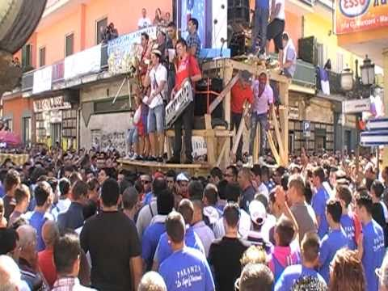
THE GIGLI FESTIVAL
THE FESTIVAL WAS INVENTED BY SOME FRIENDS: THE COMMITTEE "FANTASY". THEY WANTED TO RECREATE IN MARIGLIANELLA THE SAME DAY CELEBRATED IN BRUSCIANO AND NOLA. THE FESTIVAL WAS BORN TEN YEARS AGO, IN SEPTEMBER 1977. IT IS ON THE SECOND SUNDAY OF SEPTEMBER.
IT IS ORGANIZED IN ACCORDANCE WITH COMMITTEES ESTABLISHED BY THE CIVIL AND RELIGIOUS AUTHORITIES . THE CELEBRATION OF THE FESTIVAL LASTS THE WHOLE WEEK. THE NAMES OF THE GIGLI ARE :FANTASY, VIANOLA AND TAVERNS.
IT'S A FESTIVAL IN HONOR OF SAN GIOVANNI EVANGELISTA. THE GIGLI ARE MADE OF WOOD AND PAPIER MACHE.

Slide 13
THIS WORK WAS CREATED BY
PASQUALE GUARINO
II B
2016/17

